Slide 1
RFID BASED PARKING SYSTEM
(PR 201)

Slide 2

PDPM IIITDM JABALPUR
Mentor : Dr. Varun Bajaj
B.Tech, 2nd Year
Nishchay(2017165) | Shashi(2017236) |
Harshit(2017102) | Sahil(2017222) |
Chandresh(2017085)

Slide 3
1.Abstract 2.Components 3.Design 4.Working 5.Further Improvement And Extension
Content
Abstract
Introduction
Working
Budget

Slide 4
ABSTRACT

Slide 5
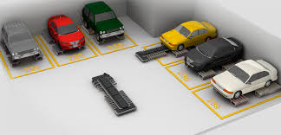
Abstract
This project aims to develop a parking system using Radio Frequency Identification (RFID).
Here, the device utilizes the RFID communication technology to provide information of the parked vehicles and help the incoming vehicles to park.

Slide 6
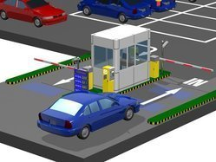
Abstract
One of the most popular problems which are faced by many institutes or universities is the parking problem.
The parking system is not well managed and the vehicles are get parked at random places in the campus.

Slide 7
COMPONENTS

Slide 8
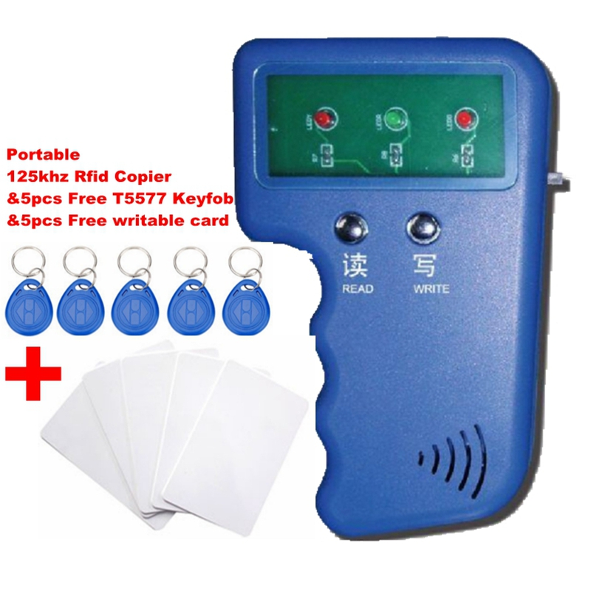
Introduction
What is RFID?
Radio Frequency IDentification (RFID) is a generic term used to describe a system that transmits the identity of an object or person wirelessly using radio wave.

Slide 9
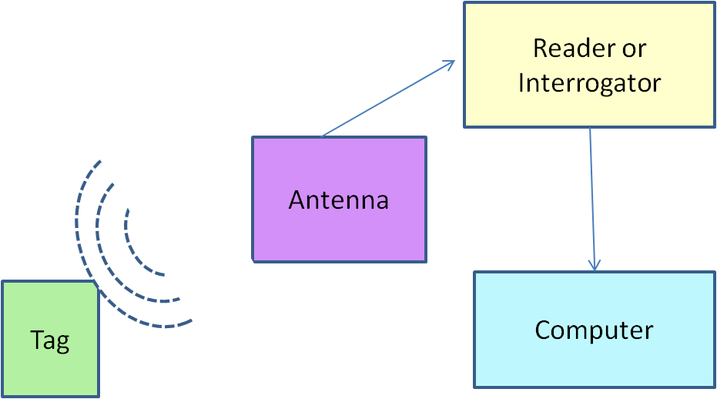
Introduction
Parts of an RFID System-
Any RFID system is made up of two parts:
a tag or label
a reader

Slide 10
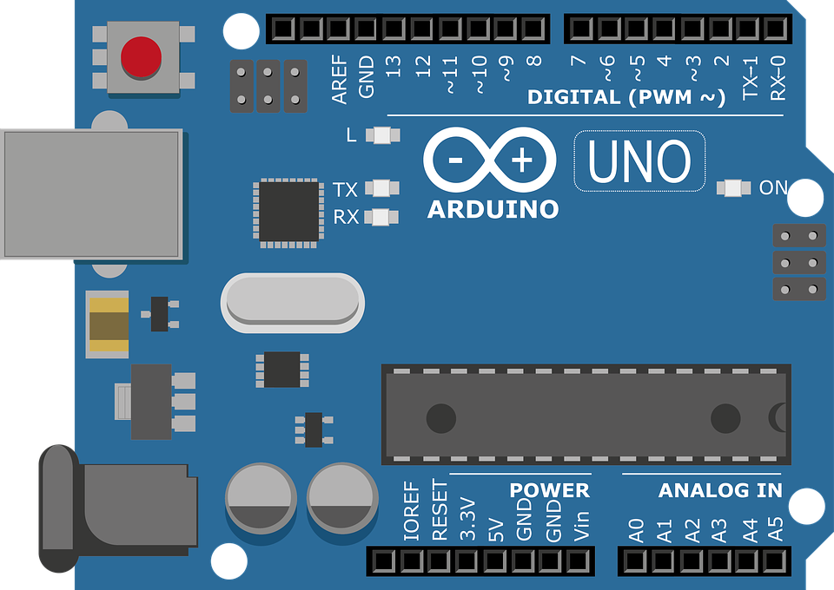
Microcontroller
Introduction
We look forward to use Arduino Uno as a microcontroller in our project

Slide 11
Microcontroller
Introduction
Use Case
Processes Inputs from other parts of circuit
Initiates appropriate protocols upon trigger
Brain of the device

Slide 12
Microcontroller
Introduction
Features
Can be programmed specifically to suit our requirements
Handles multiple inputs and outputs simultaneously

Slide 13
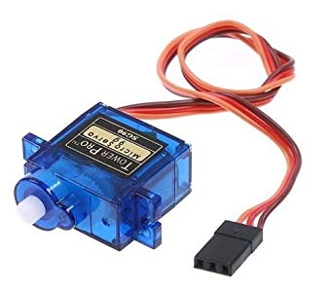
Servo Motor

Slide 14
Servo Motor
Servo motor works on PWM (Pulse width modulation) principle, means its angle of rotation is controlled by the duration of applied pulse its Control PIN.
Basically servo motor is made up of DC motor which is controlled by a variable resistor (potentiometer) and some gears

Slide 15
Components List
1. Jumper wire 2. RFID 3. Bread board 4. LEDs 5. Servo motor 6. Arduino 7. Gsm module 8. Cardboard

Slide 16
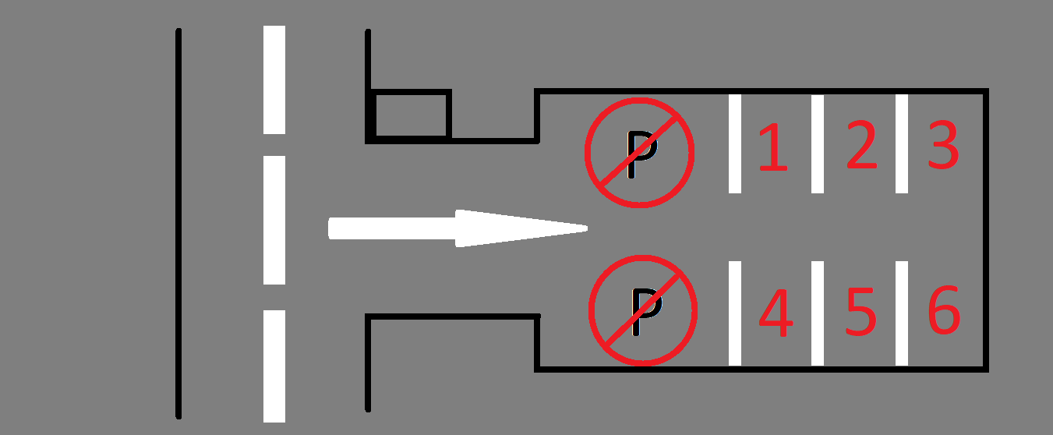
Basic Model

Slide 17
WORKING

Slide 18

Working
RF Communication
Radio Frequency Communication between the tag and the reader is the essence of our idea.
Moving ahead, we have worked upon two approaches to handle the working of communication.

Slide 19
Working
Brief working
RFID tags are placed on the parking slots.
When a vehicle gets parked in the slot , the reader will get the signals and the information will be stored .
Thus the display will show the empty space remaining for rest of the vehicles for parking .

Slide 20
Working
CASES
If car do not arrive in the parking zone then according to the code after the decided time the person will get the warning that he/she has to park the vehicle in the parking zone.
If the car arrived at the parking slot then it gets detected by the reader and then we get the information about the spaces.
If the car again parks in the no parking zone and tries to get out before the warning time then he will get caught at the entrance gate.

Slide 21
Budget
1. Jumper wire : 239 2. RFID : 1400 3. Bread board: 557 4. LEDs( red/green): 364 5. Servo motor: 196 6. Arduino: 1359 9.Buzzer: 130 TOTAL = Rs 4245

Slide 22
Further Improvement and Extension
1. After the successful execution of the prototype , we have decided to take it to the institute level.
2. So for that the components list is given below and all the connections will be wireless as it would be difficult for us to do all the complex connections.
3. In the prototype, the system is not developed to send direct messages to the persons, so in the improvement we have decided to include this also in our model.
4. So if the person coming to the institute will not park the vehicles in the parking zone then that person will get a warning message that park the car in the parking zone otherwise the fine will be generated.

Slide 23
For 10 parking slots of the institute
10 RFID
LED screen
Blocking rod
4. Controller
5. Motors
GSM module
RF module

Slide 24
Thank You!
Nishchay | Shashi | Harshit | Sahil | Chandresh

